Slide 1
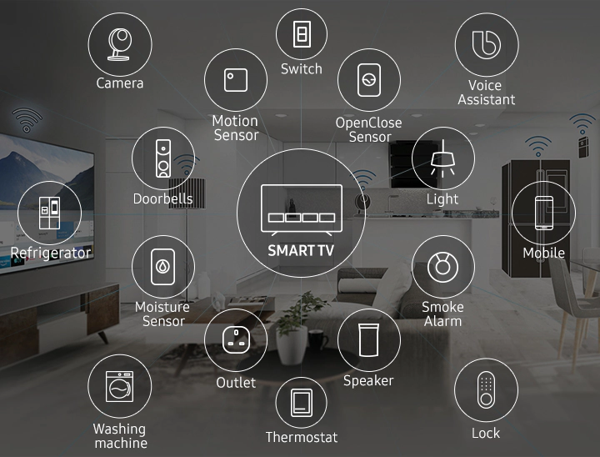
Internet of Things (IoT) and Smart Contracts in the Smart Home Industry
Group 6: FinTech Future
Amjad Alqarni
Sarah Almaghthawi
NadaAlGhamdi
Somaya Abodabeel
Malak Alsuroor

Slide 2
Smart home gateway A few technologies for smart homes grafted as interest in the residential environment is growing due to technological development. Smart Home refers to a residential or living environment equipped with technologies that can automatically control devices and systems. 1-significant installation costs. 2-Reliable internet connection is crucial. 3-Security issues. 4-Technological problems in connected homes. 5-You may lock yourself out of your own house. 6-Helplessness if technology fails. 7-Some people may not like smart technologies. 8-Maintenance and repair issues.

Slide 3
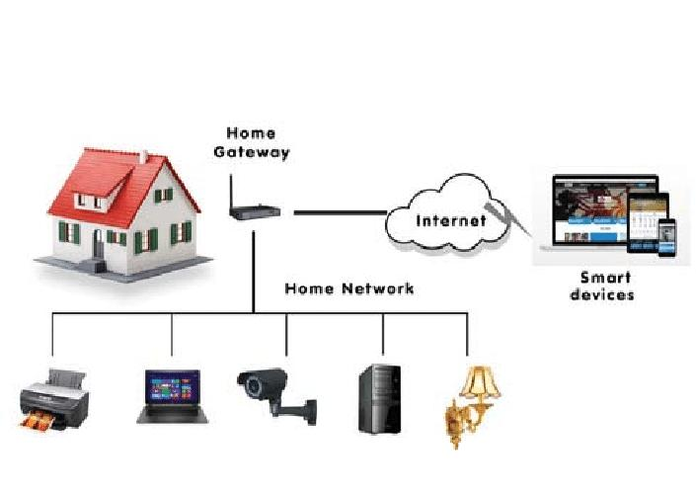
Blockchain mechanism is feasible for the potential smart home user who does not have any trust in third-party providers and wants their sensitive information to remain confidential in their home premises.
Some of the problems of IoT are given below:
Security
All IoT devices are connected through networks. For communication or interaction is using the Internet.
Privacy
Even without the active participation of the user, the IoT system provides substantial personal data in maximum detail.
Centralized Data
All the data is stored at a central data storage. If that server fails, then the entire device will not be controllable.

Slide 4

Example
Telstra, an Australian telecommunication and media company, provides smart home solutions. The company has implemented blockchain and biometric security to ensure no one can manipulate the data captured from smart devices. Sensitive user data is stored on the blockchain for improved security, such as: biometrics voice recognition facial recognition Once the data is saved on the blockchain, it cannot be modified, and the access is only provided to the right person.
https://www.telstra.com.au

Slide 5
References
https://hcis-journal.springeropen.com/articles/10.1186/s13673-020-0214-5
https://www.ibm.com/topics/blockchain-iot
https://www.leewayhertz.com/blockchain-iot-use-cases-real-world-products/
Telstra: Broadband Internet, NBN, 5G, TV & Mobile Phone Services

Slide 6
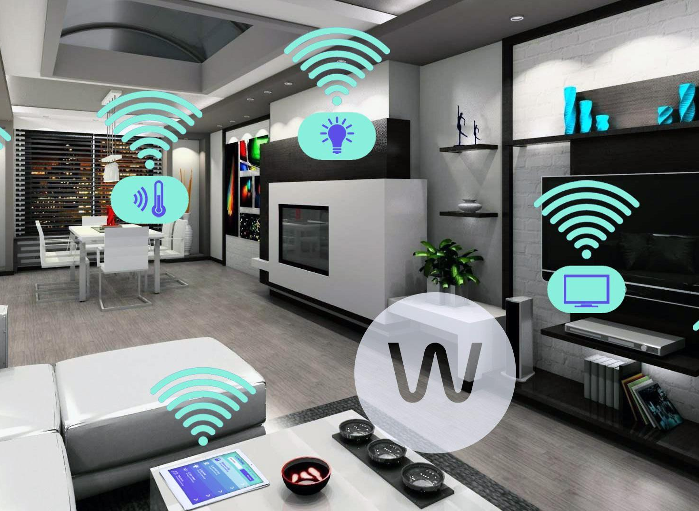
Thanks for listening

